Slide 1



HashiCorp Vault : Getting Started
Introducing HashiCorp Vault

Slide 2
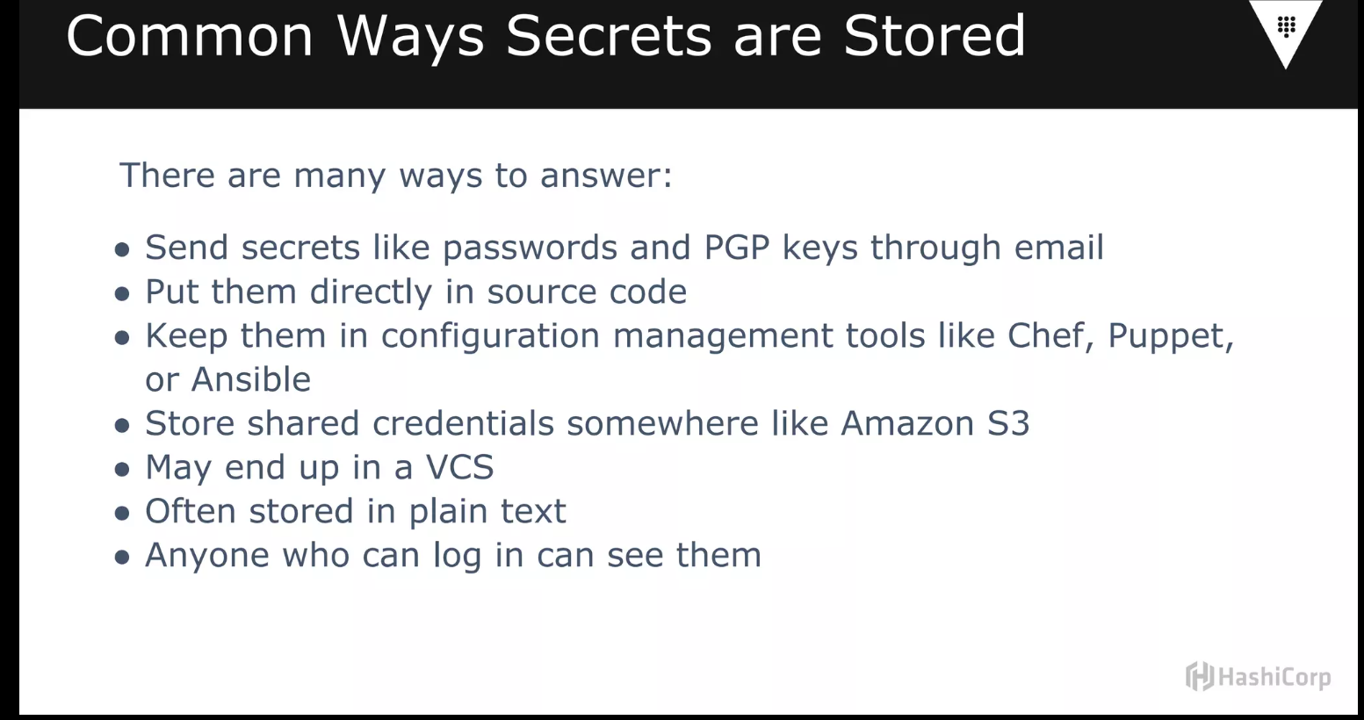

Slide 3
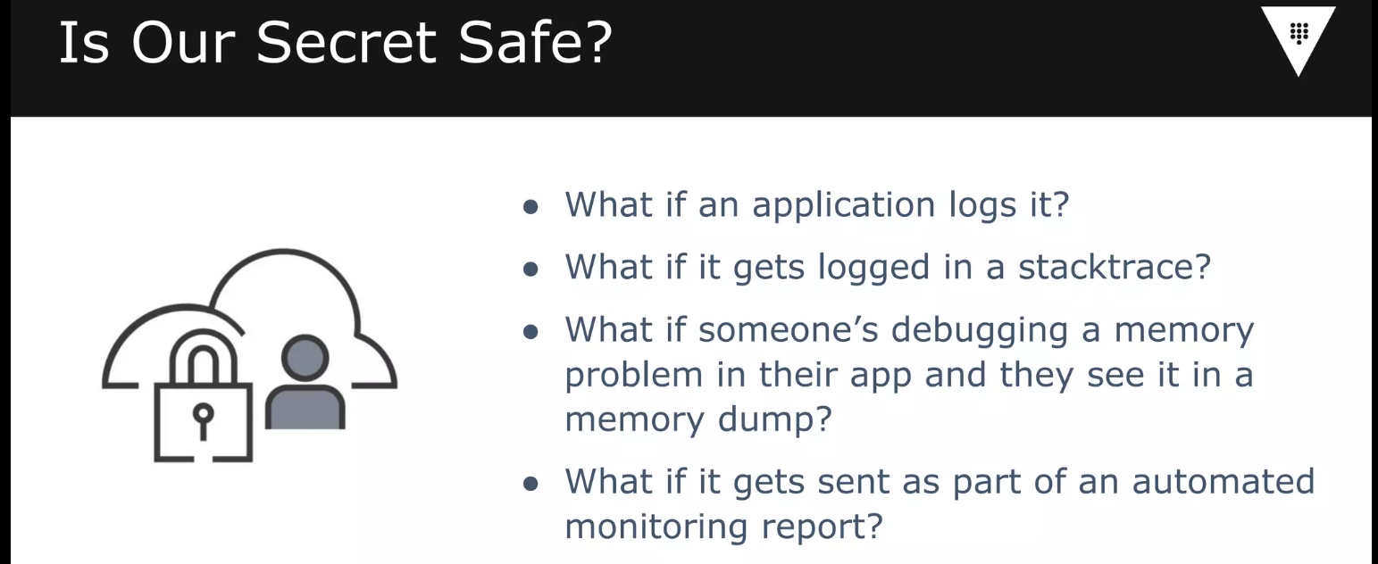
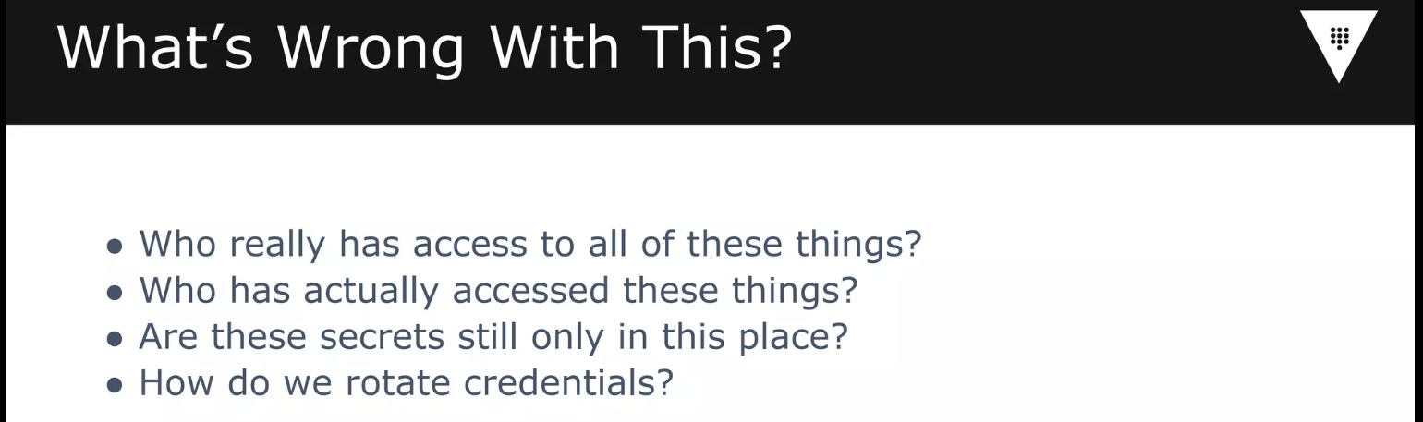

Slide 4

Key features of Vault
A best-in-class secrets management solution will have support for both static and dynamic secrets that can be use for
Machine-to-Machine
Human-to Machine access
These different types of secrets include
Encryption keys
API-keys
Tokens
Passwords
SSH certificates
x.509 certificates
Signing keys and more

Slide 5
Key features of Vault
It provides an easy way to manage secret sprawl
It allows dynamic secrets
It’s open source
It is self-hosted
It can be used to encrypt data of your applications
It can generate your PKI certificates
Vault’s functionality can be extended with Secret Engines and Auth Engines
It has a fast release cycle
Secure Secret Storage
Data Encryption
Leasing and Renewal
Revocation
Secret Rotation
Audit Control

Slide 6
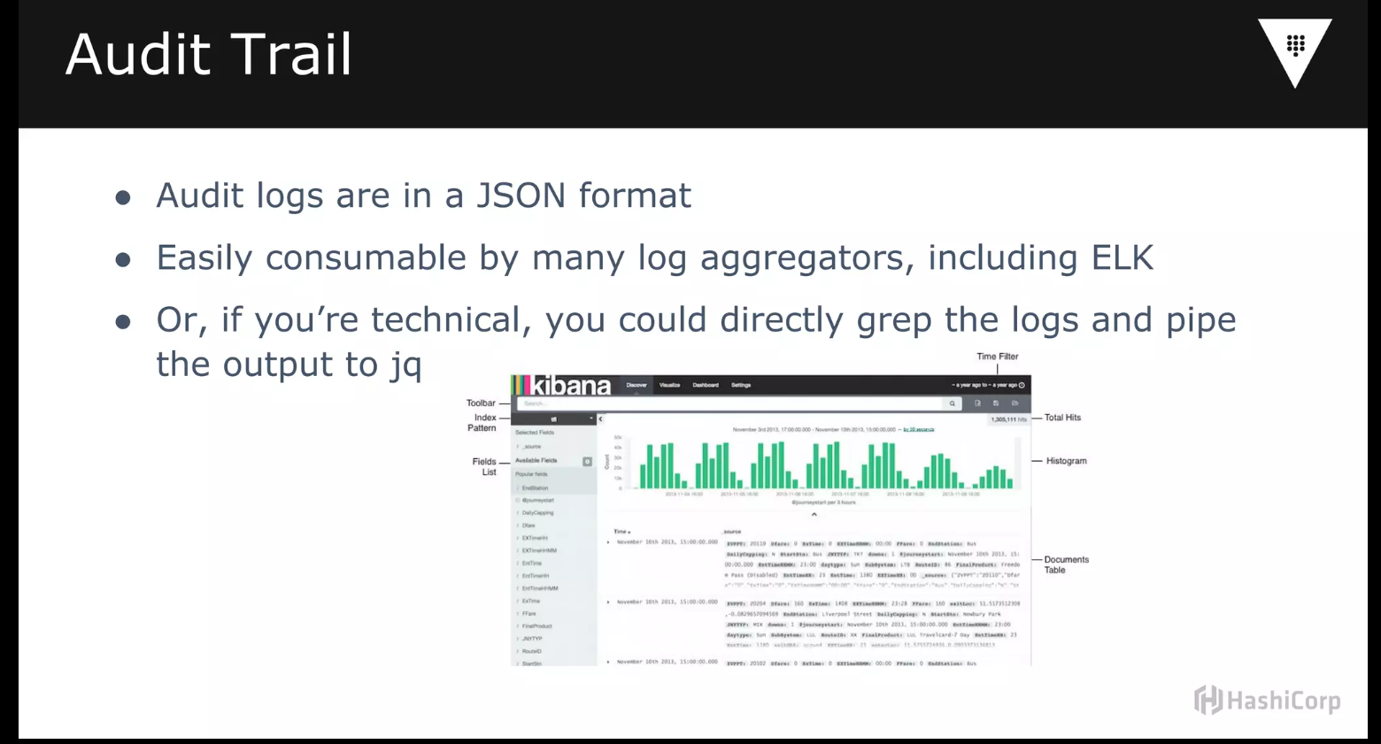

Slide 7















Vault Concepts
Authentication
Policy
Secrets
Clients
Audit

Slide 8
Vault Initialization

Slide 9
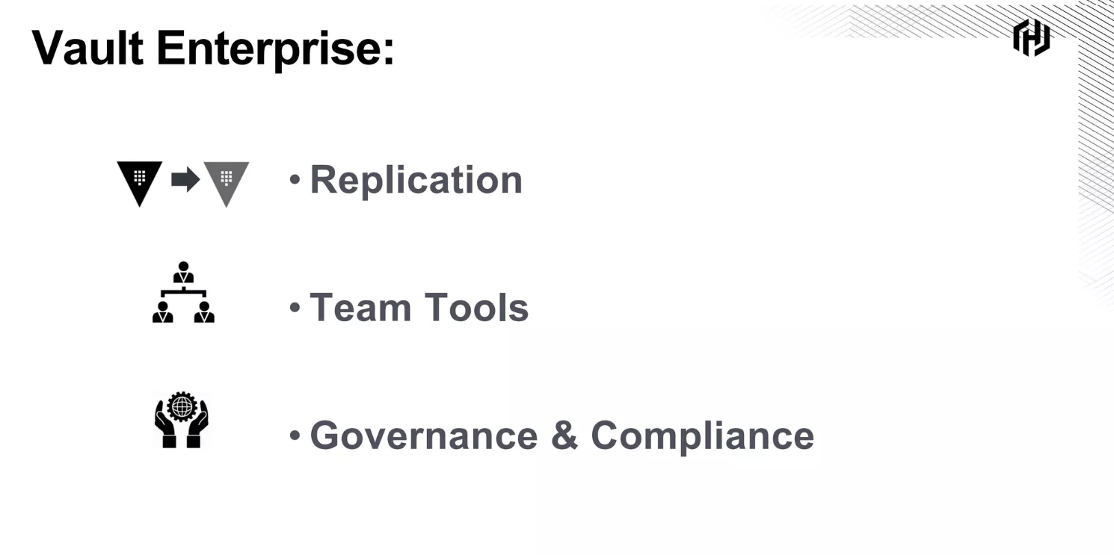

Slide 10
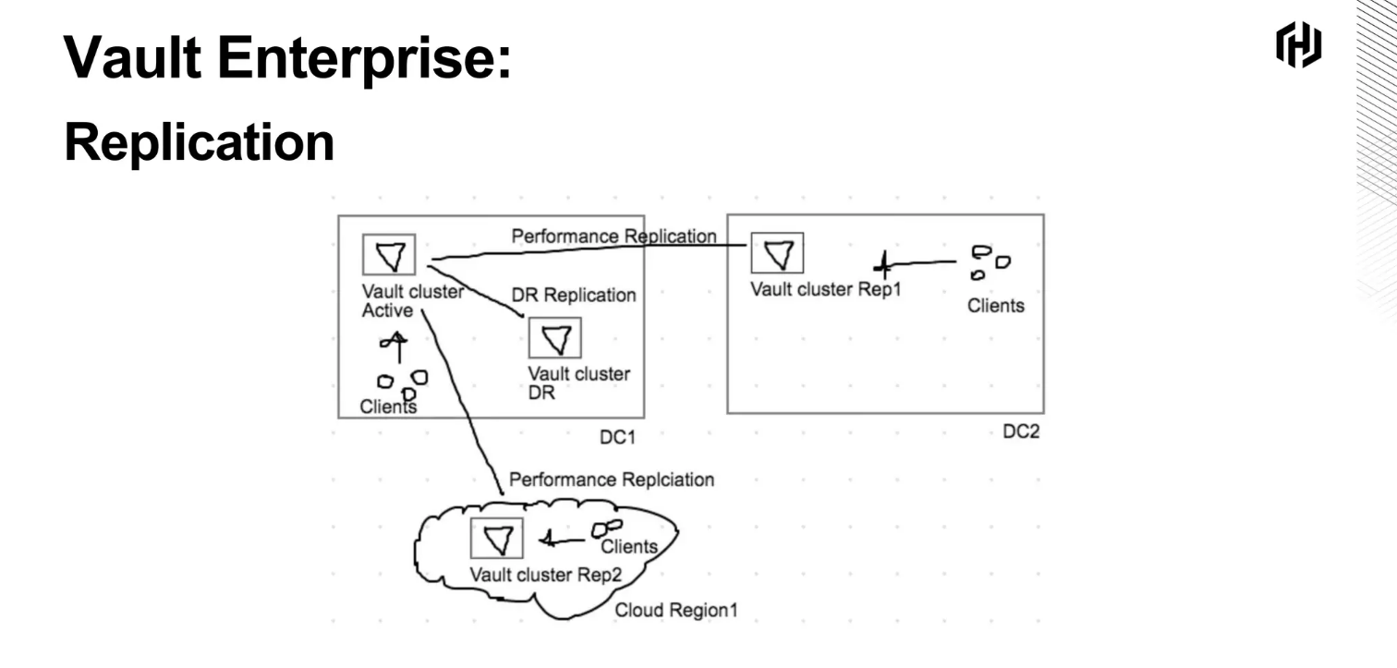

Slide 11
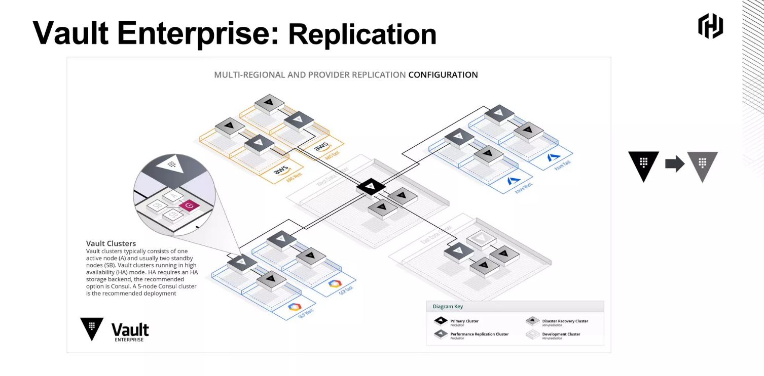

Slide 12
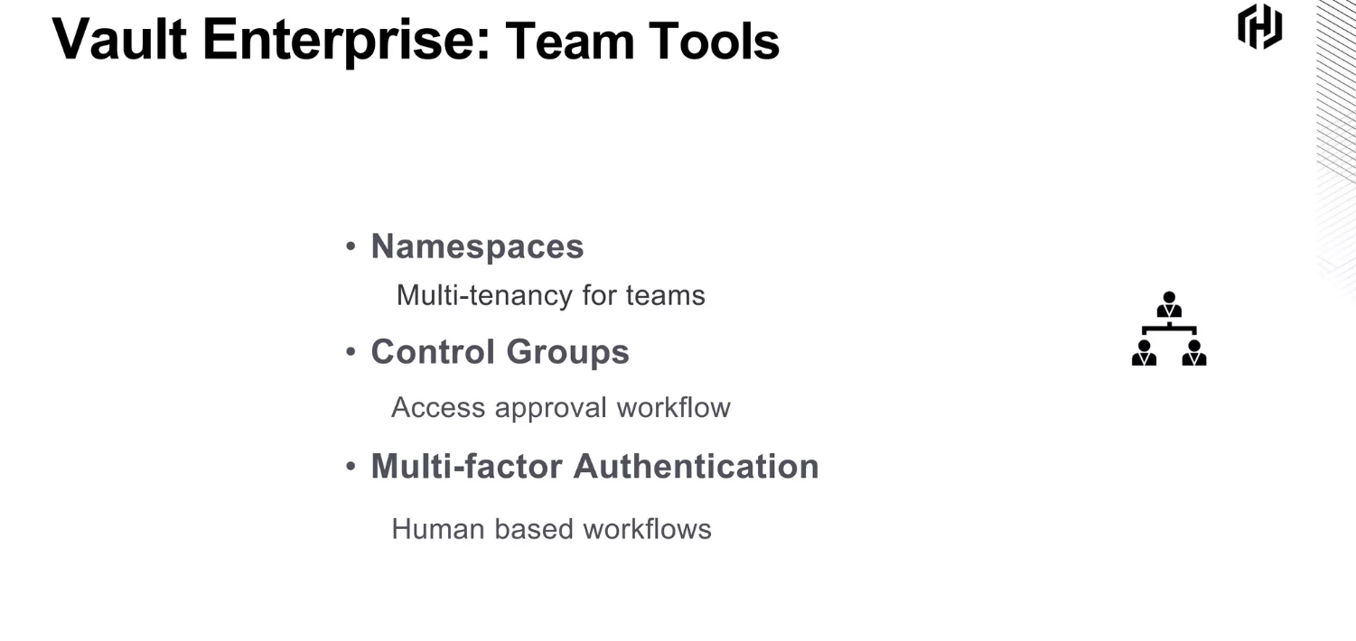

Slide 13
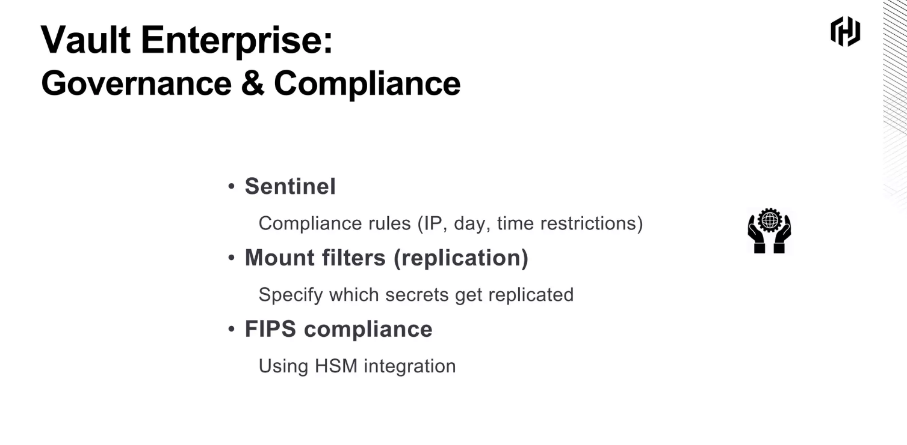

Slide 14
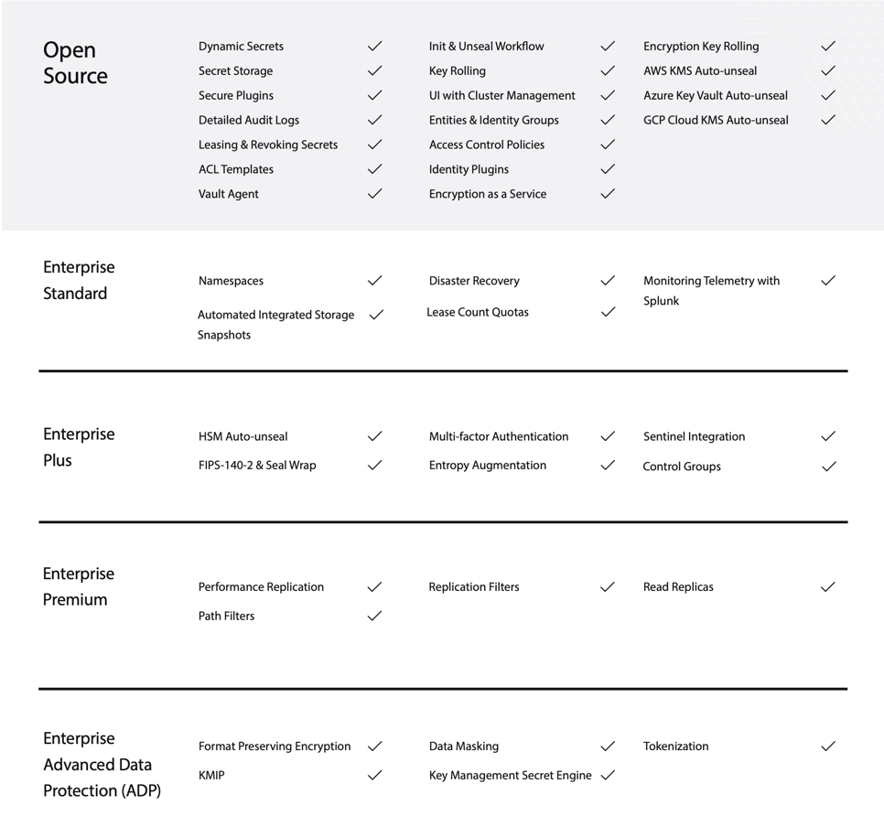

Slide 15
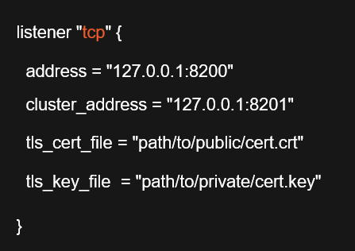
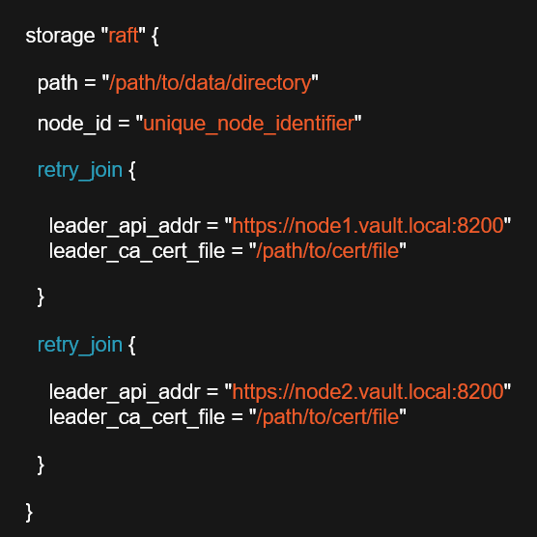

Vault-Config.hcl
listener "tcp" {}
seal "type_name" {} storage "type_name" {}
service_registration "type" {} telemetry {}
ui = [true | false] disable_mlock = [true | false]
cluster_addr = "https://address:port" api_addr = "https://address:port"

Slide 16

Initializing Vault
# Get Vault server status
vault status
# Initialize Vault server
vault operator init [options]
vault operator init –key-shares=5 –key-threshold=3
vault operator init –recovery-shares=5 –recovery-threshold=3
Unseal Vault
# Start unseal process
vault operator unseal [options] [KEY]
# Seal an unsealed Vault server
vault operator seal [options]

Slide 17

Key Takeaways
All data that leaves the barrier will be encrypted.
Data leaving the front-end API is encrypted using TLS. Data written to back-end storage is encrypted using the Encryption keys.
The Encryption keys are protected by the Master key which is protected by the Unseal key.
The Unseal key is never stored in Vault and can be broken into Shamir key shares or stored on a Cloud/HSM service.
The Vault must be unsealed before use with the Unseal key.

Slide 18
Key Takeaways
Vault server configuration is defined by an HCL or JSON file and environment variables.
Storage backends can be HashiCorp or Community supported, and may support high-availability.
Vault server must be initialized on first startup and unsealed after every startup.
The Master and Unseal keys can be updated using the rekey operation.
The Encryption keys can be changed using the rotate operation.

Slide 19
VAULT_ADDR – Address of the Vault server
VAULT_TOKEN – Token value for requests
VAULT_SKIP_VERIFY – No verify TLS cert VAULT_FORMAT – Specify output format
Environment Variables

Slide 20
Key Takeaways
Vault is a single binary for client and server
Vault can be started in dev mode for local testing All Vault communication goes through the API
You can interact with Vault using the CLI, UI, or API Use VAULT_ADDR and VAULT_TOKEN with the CLI

Slide 21
Authentication Methods Overview

Slide 22




Authentication Method Categories
Cloud providers: AWS, Azure, GCP
Cloud native: Kubernetes, Cloud Foundry, GitHub, JWT
Traditional: LDAP, RADIUS, Kerberos
Vault native: Token, Userpass, AppRole

Slide 23
Secrets Engine Categories
Cloud AWS, Azure, GCP
Database MSSQL, PostreSQL,
MondoDB
Internal Key/Value, Identity,
Transit
Identity Active Directory,
OpenLDAP
Certificate SSH, PKI, Venafi
Tokens Consul, Nomad

Slide 24
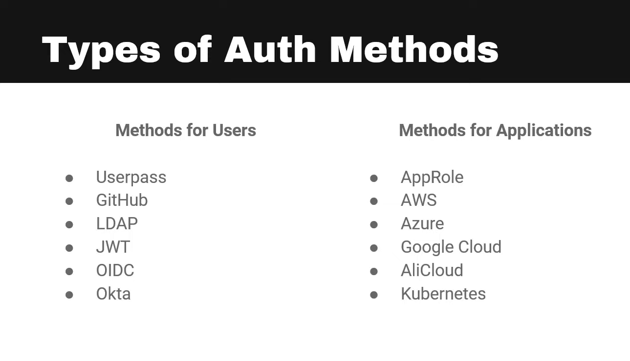

Slide 25
Auth Method Commands
# List existing auth methods
vault auth list
# Enable an auth method
vault auth enable [options] TYPE
vault auth enable –path=mcu userpass # Tune an auth method
vault auth tune [options] PATH
vault auth tune –description="First userpass" mcu/ # Disable an auth method
vault auth disable [options] PATH vault auth disable mcu/
# Login using a token
vault login
# Login with an auth method
vault login [options] [AUTH K=V…]
vault login –method=userpass username=Captain # Write with an auth method
vault write [options] PATH [DATA K=V…]
vault write auth/userpass/login/ned password=America

Slide 26
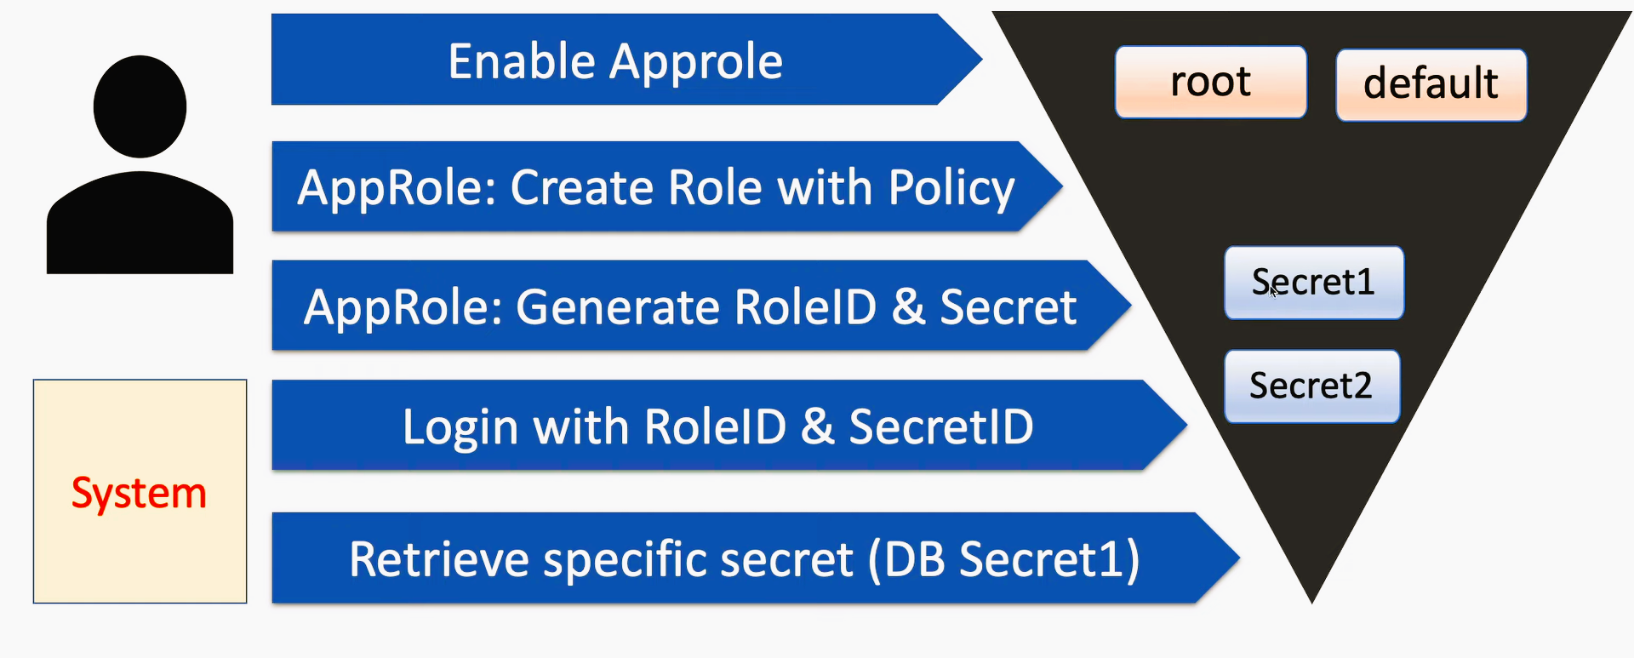
App Role Pull Authentication

Slide 27
Key Takeaways
Auth methods use internal or external sources for authentication to Vault
Multiple instances of the same method can be enabled on different paths, and the default path is the method's name
Pick an authentication method that suits the client and environment
Auth methods are managed using the vault auth command
Auth methods are used with the vault login or vault write commands

Slide 28
Policies define permissions in Vault
Multiple options for assignment
- Token, identity, auth methods
Most specific wins No versioning
Default policy Root policy
Vault Policy

Slide 29



Capabilities
List - enumerate keys
No access to key data
Not implied by the read
Sudo – special permissions
Root-protected paths
Do not imply other actions
Deny – disable access
Overrides all other actions
Denies the full path
Standard CRUD capabilities
Create – create a new key Read – read data from a key Update – alter data for a key
Delete – remove a key

Slide 30
Capability Examples
# Allow read access to an apikey
path "secrets/mcu/webapp/apikey" { capabilities = ["read"]
}
# Allow full access to apikey in globo paths
path "secrets/mcu/+/apikey" {
capabilities = ["create","read","update","delete"]
}
# Deny access to the globo privileged path path "secrets/mcu/webapp/*" {
capabilities = ["create","read","list","update","delete"]
}
path "secrets/mcu/webapp/privileged*" { capabilities = ["deny"]
}
# Allow read and list access to webapp path
path "secrets/mcu/webapp/*" { capabilities = ["read","list"]
}

Slide 31
Working with Policies
# List existing policies
vault policy list
# Delete a policy
vault policy delete [options] NAME vault policy delete secrets-mgmt
# Read the contents of a policy
vault policy read [options] NAME vault policy read secrets-mgmt
# Format a policy per HCL guidelines
vault policy fmt [options] PATH vault policy fmt secrets-mgmt.hcl
# Write a new policy or update an existing policy
vault policy write [options] NAME PATH | <stdin> vault policy write secrets-mgmt secrets-mgmt.hcl

Slide 32
Assigning a Policy
# Associate directly with a token
vault token create –policy="secrets-mgmt"
# Assign to a user in userpass
vault write auth/userpass/users/Captain token_policies="secrets-mgmt"
# Assign to an entity in identity
vault write identity/entity/name/Captain policies="secrets-mgmt"
# Assign to an approle
vault write auth/approle/role/Jenkins token_policies=“admin-policy"

Slide 33
Key Takeaways
Policies are associated with tokens directly or indirectly, defining the actions allowed by the token
The root policy can do ANYTHING. It cannot be modified or deleted.
The default policy is assigned to new tokens by default. It can be modified, but not deleted.
Paths define where actions can be taken; capabilities define what actions can be taken.
Policies can be assigned directly to a token, through an auth method, or through the identity secrets engine.

Slide 34
Vault Token Overview

Slide 35



Root Tokens
Root tokens can do ANYTHING
Do not expire Created in three ways
Initialize Vault server
Existing root token
Using operator command
Revoke as soon as possible
Perform initial setup
Auth method unavailable
Emergency situation

Slide 36
Working with Tokens
# Create a new token
vault token create [options]
vault token create –policy=my-policy –ttl=60m
# View token properties
vault token lookup [options] [ ACCESSOR | ID ]
vault token lookup -accessor FJkyU35ihsMf3nKOLWdOUqdY
# Check capabilities on a path
vault token capabilities TOKEN PATH
vault token capabilities s.TG9U2ZdtPU1Hmz18BcujrETI secrets/apikeys/

Slide 37
Working with Token Lifetime
# Renew a token
vault token renew [options] [ACCESSOR | ID ] [ -increment=<duration> ] vault token renew -increment=60m
# Revoke a token
vault token revoke [options] [ ACCESSOR | ID ]
vault token revoke -accessor FJkyU35ihsMf3nKOLWdOUqdY

Slide 38
Key Takeaways
Tokens are the fundamental way of interacting with Vault. Can be issued through auth methods, operator command, or other tokens.
Root tokens can do ANYTHING. Requires unseal or recovery keys to create. Should be revoked as soon as possible.
Accessors are used to manage tokens without having access to their ID or permitted actions.
Service tokens are the default and persistently stored. Batch tokens are limited, ephemeral, and are used for high-volume applications.

Slide 39
Key Takeaways
Token TTL is the amount of time a token is valid for. Tokens can be renewed for additional time within the effective max TTL.
Periodic tokens can be renewed forever based on a period TTL. Require elevated permissions and may have an explicit max TTL.
Tokens have a hierarchy of parent/child. Revoking a parent token revokes the children by default. Orphaned tokens have no parent.

Slide 40
Secrets Engine Overview

Slide 41
Secrets Engine Categories
Cloud AWS, Azure, GCP
Database MSSQL, PostreSQL,
MondoDB
Internal Key/Value, Identity,
Transit
Identity Active Directory,
OpenLDAP
Certificate SSH, PKI, Venafi
Tokens Consul, Nomad

Slide 42
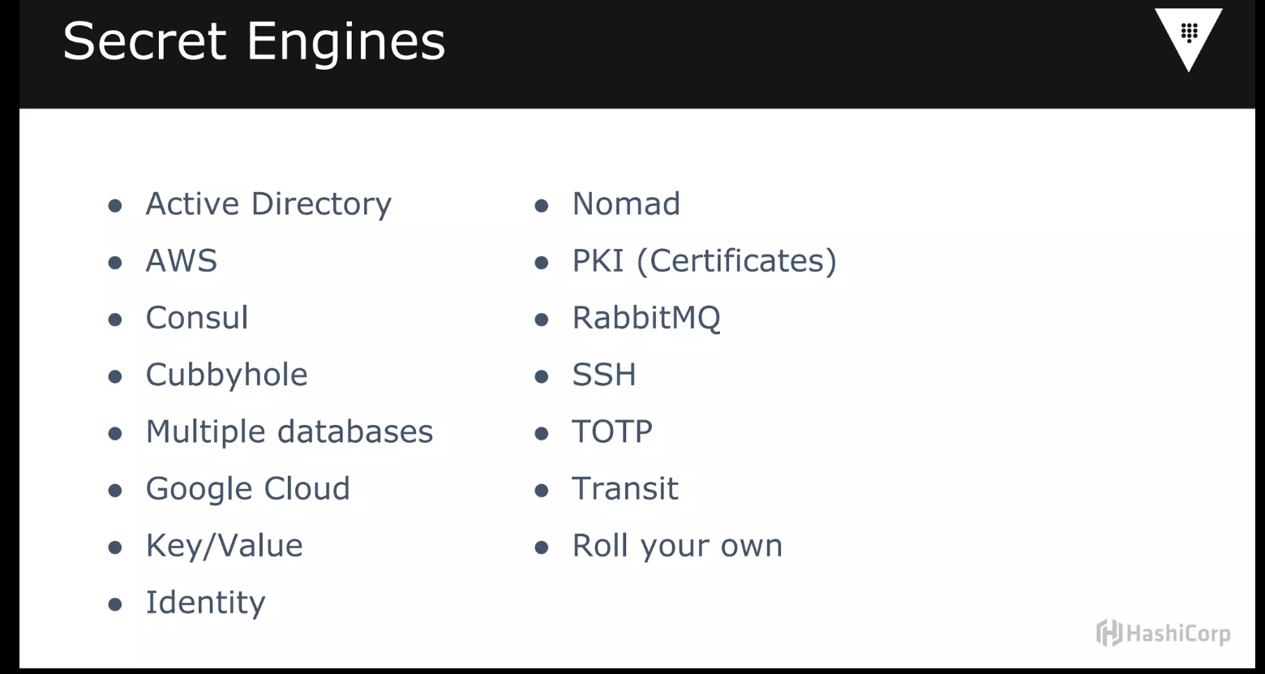

Slide 43

Dynamic vs. Static Secrets
Static secrets
Store existing data securely
Manual lifecycle management
Key/Value engine
Dynamic secrets
Generate data on demand
Lease issued for each secret
Automatic lifecycle management
Majority of secrets engines
Consul engine

Slide 44
Working with Secrets Engines
# List existing secrets engines
vault secrets list
# Move an existing secrets engine
vault secrets move [options] SOURCE DEST vault secrets move mcu-kv mcu-kv1
# Enable a new secrets engine
vault secrets enable [options] TYPE vault secrets enable –path=mcu-kv kv
# Disable a secrets engine
vault secrets disable [options] PATH vault secrets disable mcu-kv1
# Tune a secrets engine setting
vault secrets tune [options] PATH
vault secrets tune –description="Marvel Default KV" mcuKV

Slide 45
Interacting with the Key Value Engine
# Writing a secret value
vault kv put [options] KEY [DATA K=V]
vault kv put mcu-kv/apikeys/d101 token=1234567890
# Deleting a value
vault kv delete [options] KEY
vault kv delete –versions=1 mcu-kv/apikeys/d101
# Listing secret keys
vault kv list [options] PATH vault kv list mcu-kv/apikeys/
# Destroying a value
vault kv destroy [options] KEY
vault kv destroy –versions=1 mcu-kv/apikeys/d101
# Reading a secret value
vault kv get [options] KEY
vault kv get –version=1 mcu-kv/apikeys/d101

Slide 46
Interacting with the Consul Engine
# Use vault write to configure roles
vault write ROLE_PATH [SETTINGS K=V]
vault write consul/roles/my-role name=my-role policies=consul-policy
# Use vault read to retrieve credentials
vault read CRED_PATH
vault read consul/creds/my-role

Slide 47
Using Response Wrapping
# Request wrapping for any command
vault command –wrap-ttl=<duration> PATH
vault kv get –wrap-ttl=<duration> GloboKV/apikeys/d101
# Unwrap using the issued token
vault unwrap [options] [TOKEN]
vault unwrap s.a1xgFuJZgw1KJPY2MGUPdMLw

Slide 48
Key Takeaways
Secrets engines are Vault plug-in that can store, generate, and encrypt data.
Static secrets engines store external data in Vault. Dynamic secrets engines generate credentials or data and managed the lifecycle.
The Transit engine provides encryption as a service for encypt/decrypt, sign/verify, and hashing or random data.
Secrets engines must be enabled, tuned, and configured. They can be moved, but will lose all lease data.

Slide 49
Key Takeaways
The Key Value engine has two versions and its own command set:
vault kv.
Interacting with secrets engines at the command line uses read, write, list, and delete.
Response wrapping creates a cubbyhole to store data and a single-use token to retrieve it.

Slide 50

Lease Overview
Control dynamic secret lifecycle
Dynamic secrets and service tokens Includes metadata about secret
Renew or revoke lease No direct CLI command
- Use /sys/leases/lookup path

Slide 51



Lease Properties
lease_id
lease_duration
lease_renewable

Slide 52
Working with Leases
# Lookup active leases
vault list [options] sys/leases/lookup/PATH vault list sys/leases/lookup/consul/creds/web/
# Renew a lease
vault lease renew [options] ID
vault lease renew –increment=30m consul/creds/web/KWq5o8zRVc6LtAutsta6Uf8G
# View leases properties
vault write [options] sys/leases/lookup/ lease_id=ID
vault write sys/leases/lookup/ lease_id=consul/creds/web/KWq5o8zRVc6LtAutsta6Uf8G
# Revoke a lease
vault lease revoke [options] ID
vault lease revoke consul/creds/web/KWq5o8zRVc6LtAutsta6Uf8G vault lease revoke –prefix consul/creds/web/

